Slide 1


Title: IoT prototyping using Block based programming: An use case of smart agriculture Paper ID: 4685 Presented by: Meenaxi M. Raikar, Prajwal Shavi, Neha Patil, Swati Mudavi
3nd International Conference on Artificial Intelligence and Signal Processing (AISP 2023)
18-20 March 2023
VIT-AP University

Slide 2
Outline
Motivation
Related work
Block-based programming for IoT prototype development
An use case of smart agriculture
Design and prototype of model
Design of mobile application
Proposed work
Conclusion
References

Slide 3
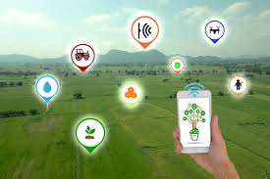
Motivation
The Internet of Things (IoT) has spread its wings in many sectors, such as autonomous driving, healthcare, agriculture, industry, home automation, and logistics.
Building the IoT prototype requires knowledge of different disciplines, namely sensors, database programming, protocols, and mobile application development.
The block-based programming removes all these dependencies and enables the student to build an IoT prototype rapidly.

Slide 4
IoT prototyping using Block based programming
Objectives:
1. To develop an IoT prototype with the use case of smart agriculture using a block-based programming platform available online.
2. To design an IoT multi-objective robot for agriculture purposes that can perform ploughing and sowing operations .
3. To store the whether details and analyse using the Firebase cloud platform.
Key contributions:
1. The block-based programming is used for IoT prototyping for the design of the mobile application to control things.
2. The prototype for smart agriculture is demonstrated for functionalities such as ploughing, sowing, and sensor connectivity to the cloud database.
3. The cloud-based storage of the data is provided for analysis that aid in decision-making and thereby increases profit.

Slide 5
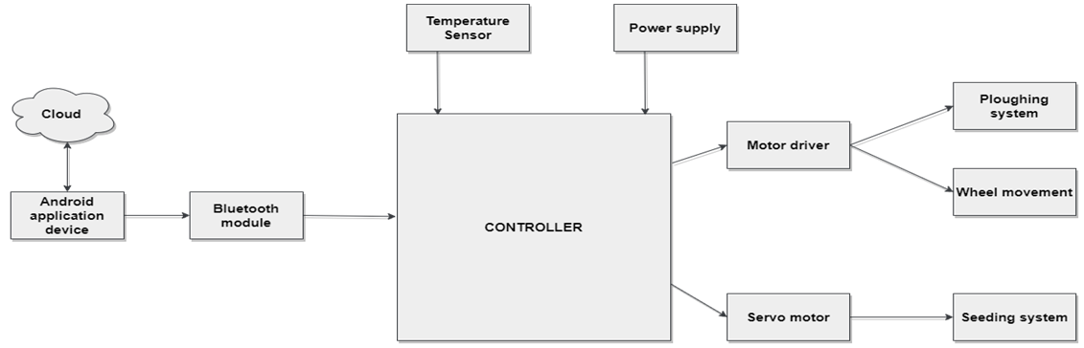
Proposed System
The proposed system is able to perform ploughing, sowing operations and can also check the temperature and humidity of the surroundings as shown in Fig 1. The proposed system architecture is formed of physical, network, database, application and security / management layer.
Fig 1. Proposed system for IoT multi-objective robot for agriculture purposes

Slide 6
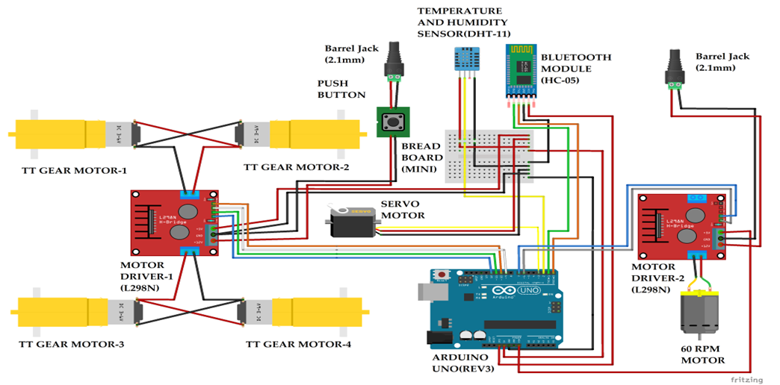
An use case of Smart Agriculture using IoT
The circuit diagram for the Smart agriculture use case is show in Fig 2.
Fig 2. Circuit diagram smart agriculture robot using IoT.

Slide 7
Proposed system architecture
The device layer is composed of sensors namely the DHT humidity and temperature sensor, actuators namely TT Gear Motor, 60 RPM DC Motor and Servo Motor.
Physical / Device Layer
The BlueTooth connectivity for communication is provided to the devices connected to the system using the HC-05 module.
Network Layer

Slide 8
Proposed system architecture
The data acquired is stored in the cloud platform using the real-time firebase DB.
All the user operations are stored in the DB along with the time and the operation that was performed.
Data / Database Layer
The block-based programming is performed for its ease of design and deployment capabilities.
The mobile app is design to command the robot.
Application Layer

Slide 9
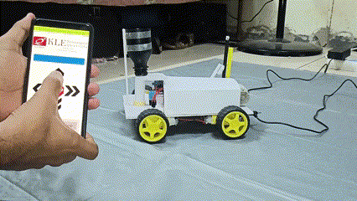
Design and prototype of the model: Movement
When any input is given using the app after connection is set up, the bot can be moved.
When any command is given, TT gear motors actuate accordingly to help the bot move.
Fig 3a. Robot movement operation

Slide 10
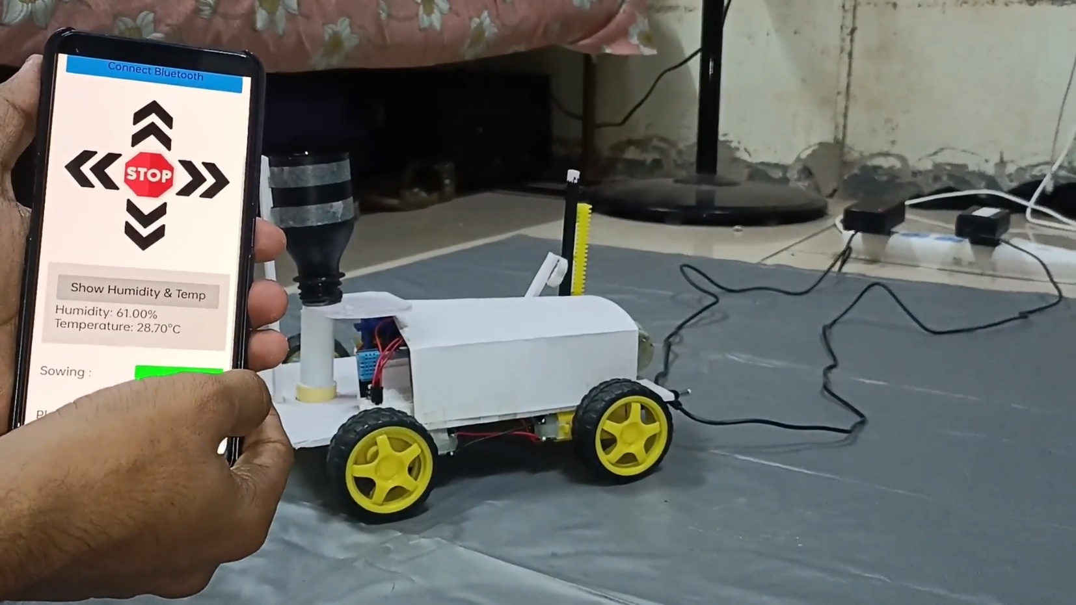
Design and prototype of the model: Temperature
When the client chooses to see temperature or humidity surrounding the bot, user can click on “Show Humidity & Temp” button on the app.
This functionality is achieved with the help of DHT11 temperature sensor that senses the surrounding humidity and temperature.
Fig 3b. Temperature and humidity sensing.

Slide 11
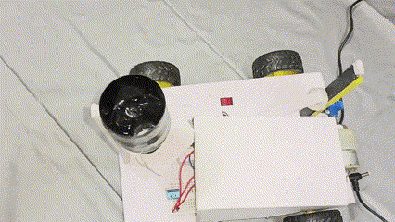
Design and prototype of the model: Sowing
When the user selects sowing operation, the Servo motor starts rotating to-and-fro motion (60°) moving forward.
The bot keeps moving forward since seed are to be sowed at certain distance.
This operation is performed until the user selects to stop the same.
Fig 3c. Sowing operation.

Slide 12
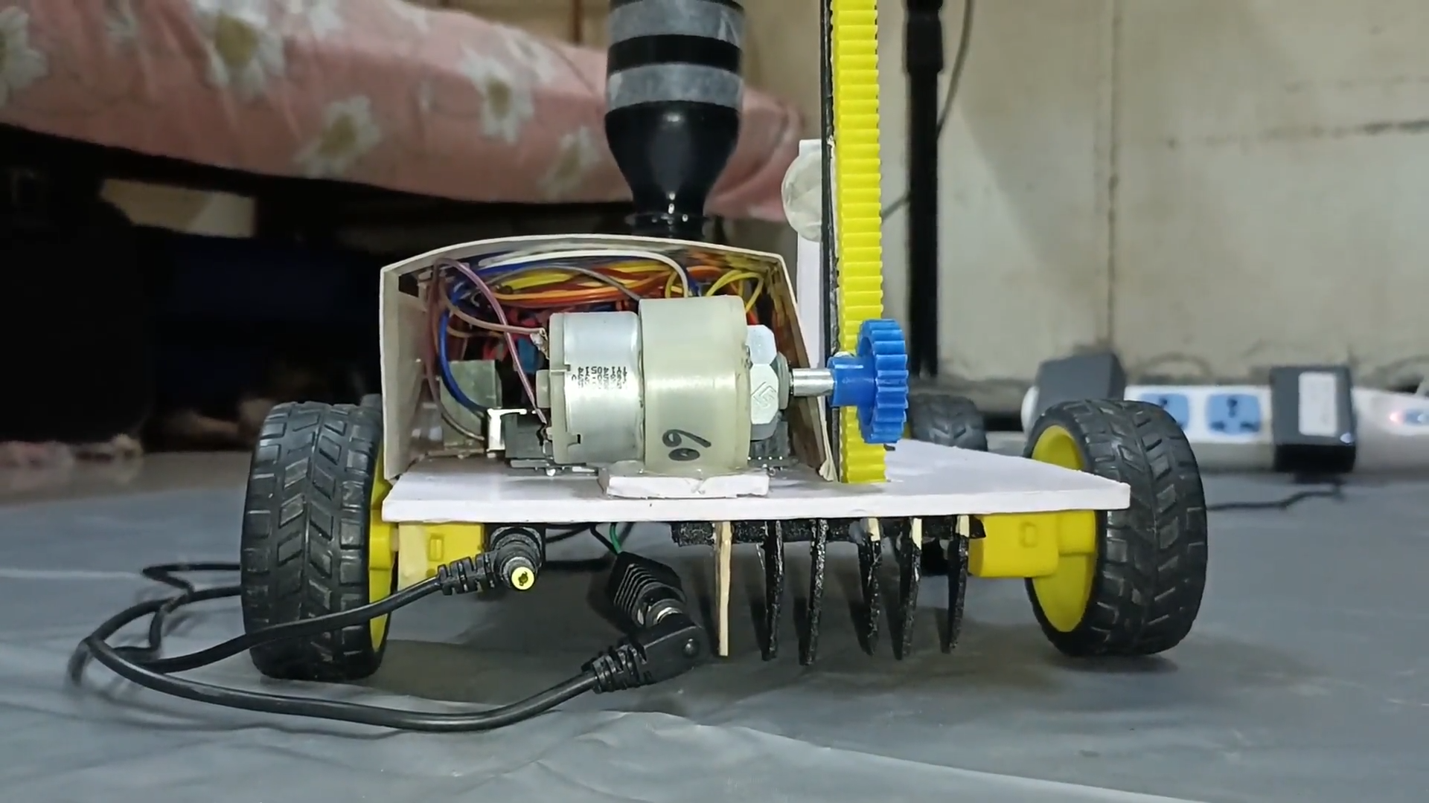
Design and prototype of the model: Ploughing
When the user chooses ploughing operation, the rotatory motion of the DC motor is converted into linear motion (Rack and Pinion mechanism).
When the user choses to stop ploughing, the plough return back to its initial position.
Fig 3d. Ploughing operation.

Slide 13
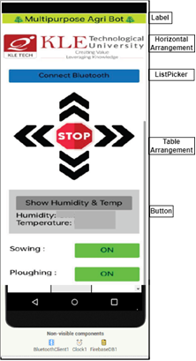
Mobile Application design
The application is designed using the MIT app inventor available online, as shown in fig 4 using block programming.
The block-based programming for IoT prototype development enables the developer to deploy the application while quickly learning the different modules.
In block-based programming, two main sections are user interface design and block building.
Fig 4. Mobile application design

Slide 14
Conclusion
The block-based programming provides a user-friendly platform for the development of the IoT prototype. The block-based programming is applied for the use case of smart agriculture.
The prototype developed includes the different components of IoT applications, such as sensor data capture, database and protocol usage, hardware and software integration, actuation, and cloud storage.
The use cases developed using block-based programming are smart conveyor belt used in industrial automation, smart notice board, smart lock, and remote vehicle tracking.
The future plan is to develop the IoT prototype using the docker containers which provides Continuous Integration / Continuous Delivery (CI / CD) and uses light weight virtualization that enables efficient sharing among the teams.

Slide 15
References
[1] Y. Tan, M. Rizk, G. Stein and Á. Lédeczi, "User-Extensible Block-Based Interfaces for Internet of Things Devices as New Educational Tools," SoutheastCon 2022, 2022, pp. 711-717, doi: 10.1109/SoutheastCon48659.2022.9763937.
[2] MIT App Inventor, [Online]. Available: http://ai2.appinventor.mit.edu/, Accessed on 06.12.2022.
[3] A. G. D. S. Junior, L. M. G. Gonçalves, G. A. De Paula Caurin, G. T. B. Tamanaka, A. C. Hernandes and R. V. Aroca, "BIPES: Block Based Integrated Platform for Embedded Systems," in IEEE Access, vol. 8, pp. 197955-197968, 2020, doi: 10.1109/ACCESS.2020.3035083.
[4] M. Hauck, R. Machhamer, L. Czenkusch, K. -U. Gollmer and G. Dartmann, "Node and Block-Based Development Tools for Distributed Systems With AI Applications," in IEEE Access, vol. 7, pp. 143109-143119, 2019, doi: 10.1109/ACCESS.2019.2940113.
[5] R. Setiawan, A. R. Anom Besari, I. K. Wibowo, M. R. Rizqullah and D. Agata, "Mobile Visual Programming Apps for Internet of Things Applications based on Raspberry Pi 3 Platform," 2018 International Electronics Symposium on Knowledge Creation and Intelligent Computing (IES-KCIC), 2018, pp. 199-204, doi: 10.1109/KCIC.2018.8628483.
[6] N. Perumalsamy, G. Sivasankar, R. M. Elavarasan, S. Kumar and B. Khan, "Design of Faulty Switching Detection and Alert System to Prevent Fatality of Servicemen During Transformer Maintenance," in IEEE Access, vol. 10, pp. 77362-77374, 2022, doi: 10.1109/ACCESS.2022.3193098.
[7] D. Jean, B. Broll, G. Stein and Á. Lédeczi, "Your Phone as a Sensor: Making IoT Accessible for Novice Programmers," 2021 IEEE Frontiers in Education Conference (FIE), 2021, pp. 1-5, doi: 10.1109/FIE49875.2021.9637272.
[8] N. Bak, B. -M. Chang and K. Choi, "Smart Block: A Visual Programming Environment for SmartThings," 2018 IEEE 42nd Annual Computer Software and Applications Conference (COMPSAC), 2018, pp. 32-37, doi: 10.1109/COMPSAC.2018.10199.

Slide 16
References
[9] T. -L. Chen, I. -A. Su and J. -K. Lee, "Case Study: Design Strategies for Enabling Visual Application Blocks of Bluetooth Library," in IEEE Access, vol. 10, pp. 52630-52654, 2022, doi: 10.1109/ACCESS.2022.3175316.
[10] Ruiz-Rube I, Mota JM, Person T, Corral JMR, Dodero JM. Block-Based Development of Mobile Learning Experiences for the Internet of Things. Sensors. 2019; 19(24):5467. https://doi.org/10.3390/s19245467
[11] S. Trilles, A. Monfort-Muriach, Á. Gómez-Cambronero and C. Granell, "Sucre4Stem: Collaborative Projects Based on IoT Devices for Students in Secondary and Pre-University Education," in IEEE Revista Iberoamericana de Tecnologias del Aprendizaje, vol. 17, no. 2, pp. 150-159, May 2022, doi: 10.1109/RITA.2022.3166854.
[12] Sobreira, Péricles de Lima et al. “Usability evaluation of block programming tools in IoT contexts for initial engineering courses.” 2020 IEEE World Conference on Engineering Education (EDUNINE) (2020): 1-5.
[13] B. R. Jerosheja and C. Mythili, "Solar Powered Automated Multi-Tasking Agricultural Robot," 2020 International Conference on Innovative Trends in Information Technology (ICITIIT), 2020, pp. 1-5, doi: 10.1109/ICITIIT49094.2020.9071542.
[14] Prajwal Shavi, “Multipurpose Agricultural Bot”, https://youtu.be/TbtXa2e0pdk, Accessed on 10.12.2022.
[15] M. Ayaz, M. Ammad-Uddin, Z. Sharif, A. Mansour and E. -H. M. Aggoune, "Internet-of-Things (IoT)-Based Smart Agriculture: Toward Making the Fields Talk," in IEEE Access, vol. 7, pp. 129551-129583, 2019, doi: 10.1109/ACCESS.2019.2932609.
[16] Meenaxi M Raikar, Meena S M, Mohammed Moin Mulla, “Software Defined Internet of Things using lightweight protocol”, Procedia Computer Science, Volume 171, 2020, Pages 1409-1418.

Slide 17
THANK YOU

